Slide 1


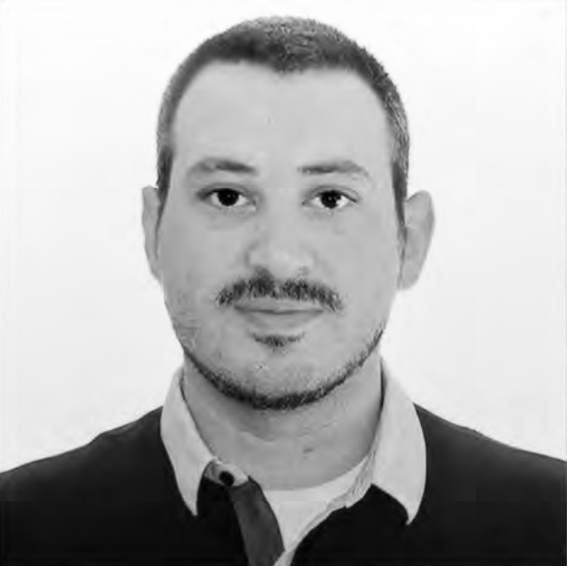


State of Filecoin
Dante Cullari
CEO - Konvergence Inc.
Web3 Architect, Full Stack Developer, UI/UX Designer, Web Researcher
dante@raincloud.earth https://raincloud.earth

Slide 2
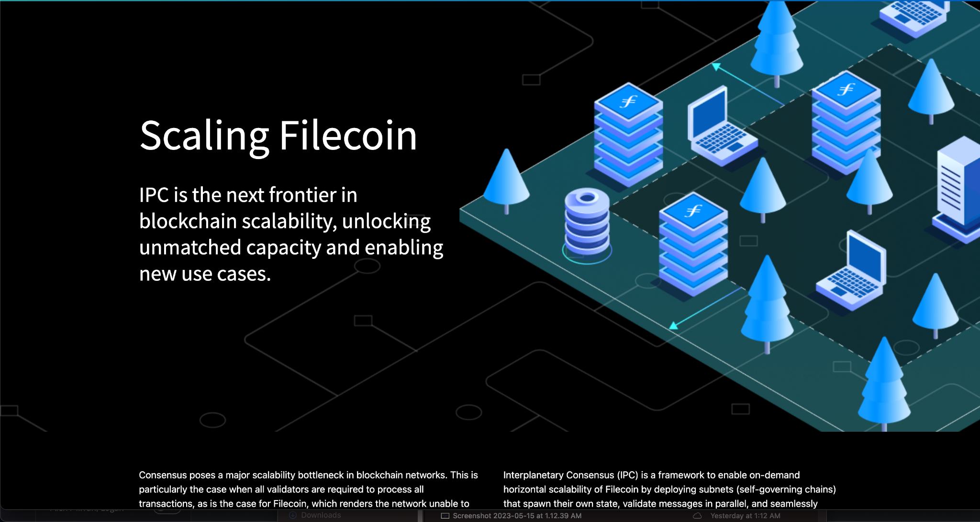
Scaling Filecoin - IPC
https://ipc.space

Slide 3
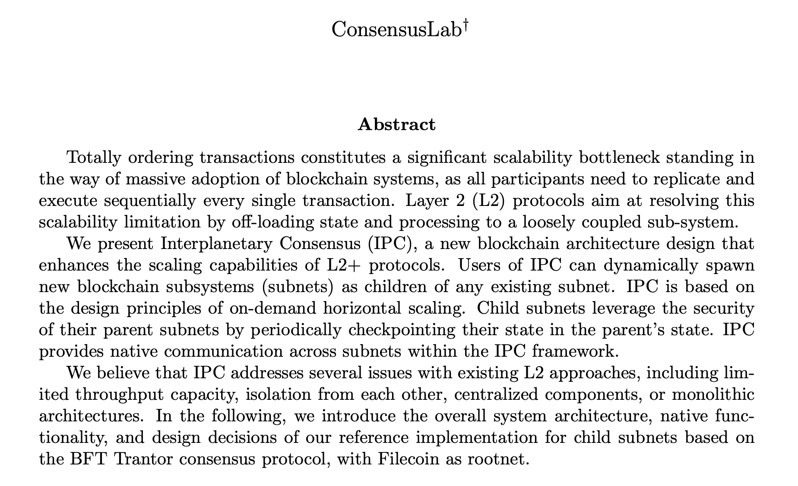
InterPlanetary Consensus - IPC
https://github.com/consensus-shipyard/IPC-design-reference-spec/raw/main/main.pdf

Slide 4

Hear it from them!
My Cal with Consensus Lab: https://app.fireflies.ai/view/Konvergence-IPC::ycmoRxJcKOdlwJK9

Slide 5
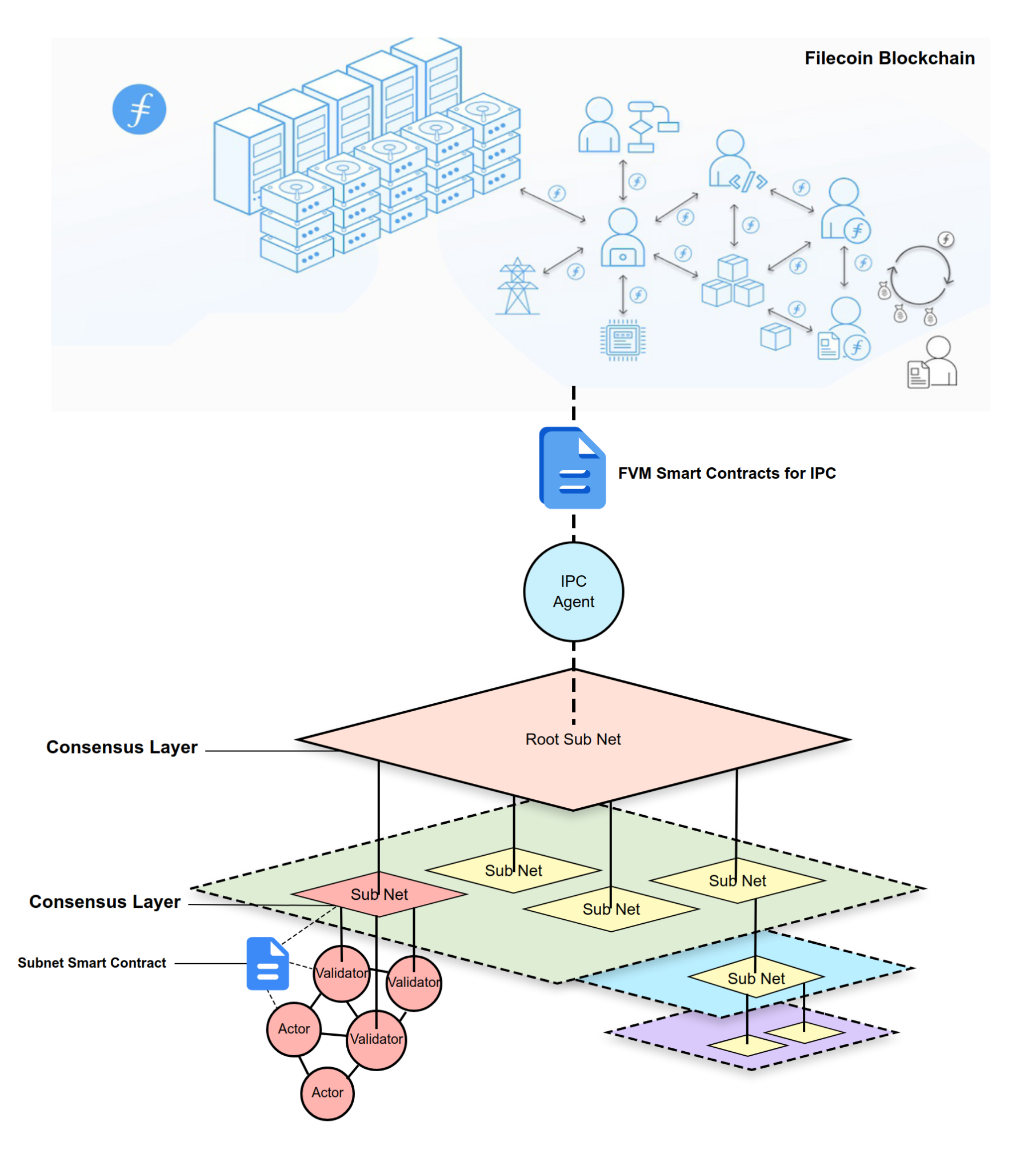
IPC Subnet Model

Slide 6
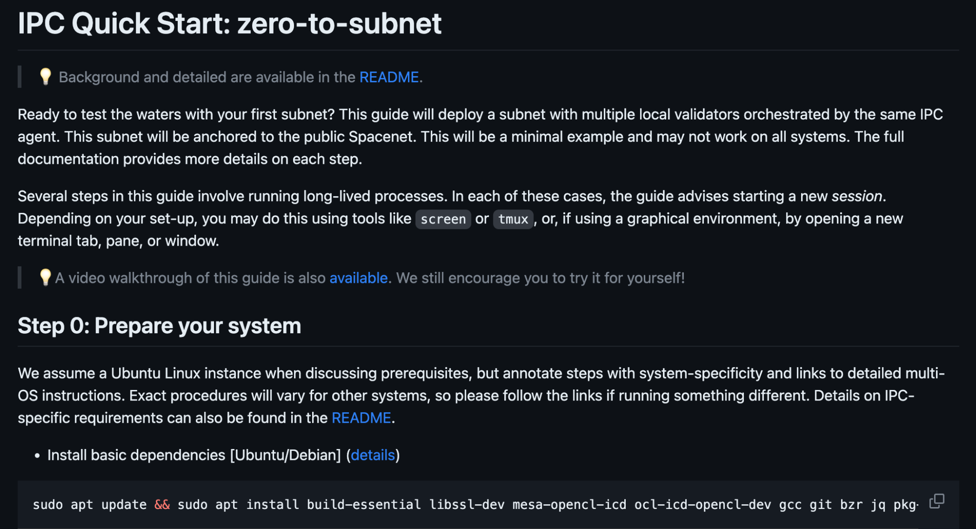
IPC Implementation
IPC-Agent Readme: https://github.com/consensus-shipyard/ipc-agent
Quickstart Guide: https://github.com/consensus-shipyard/ipc-agent/blob/main/docs/quickstart.md

Slide 7
IPC Timeline & Considerations
Still considering Architectural Issues
Communicating with Filecoin Miners
Lotus implementation, BNB Consensus Engine & Tendermint
Hoping to launch to Mainnet in July 2023

Slide 8

Join us on Slack!
Continue Discussions online
Get Event updates
Reach out to Organizers

Slide 9

Survey
Filecoin Orbit Community Program Survey

Slide 10


Thank You
dante@raincloud.earth
https://raincloud.earth
https://twitter.com/KonvergenceInc

